Slide 1
Deep Learning
Lecture 3

Slide 2
Gradient Descent
It is an optimization algorithm used in machine learning and deep learning to minimize a cost function by iteratively updating model parameters (weights and biases)
The goal is to find the best parameters that reduce prediction errors.

Slide 3
Gradient Descent

Slide 4
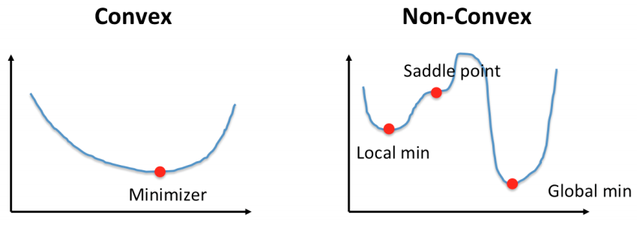
Convex VS Non-Convex
https://ai.plainenglish.io/navigating-the-terrain-convex-vs-non-convex-functions-in-optimization-86812e9a1989

Slide 5
How It Works (Intuition)
Say you're at the top of a mountain and want to reach the lowest point (global minimum).
Each step you take is based on the steepness of the slope (gradient) at your current position.
A large step (high learning rate) might cause you to jump over the minimum
A small step (low learning rate) will make progress slow but steady

Slide 6
Components of GD
Cost Function (J(θ)) – Measures the error between predicted and actual values.
Gradient (∇J(θ)) – Direction and magnitude of change in the cost function.
Learning Rate (α) – Controls the step size for updates.

Slide 7
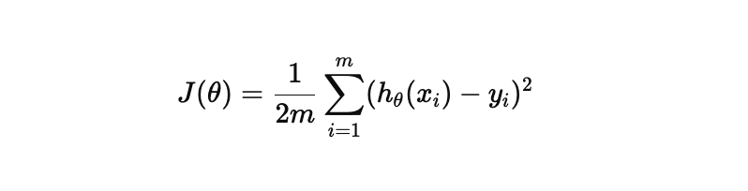
Mathematical Intuition
Cost Function (J(θ))
Gradient Descent optimizes a cost function J(θ) to minimize the error. For example, in linear regression:

Slide 8
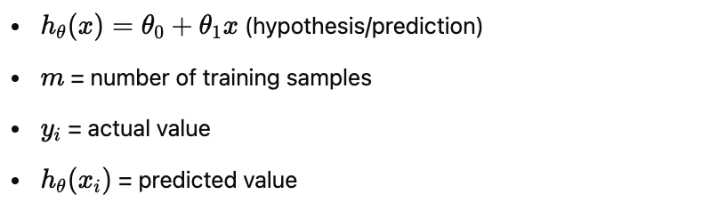
Mathematical Intuition
where:
Our goal is to find θ (theta values) that minimize J(θ).

Slide 9
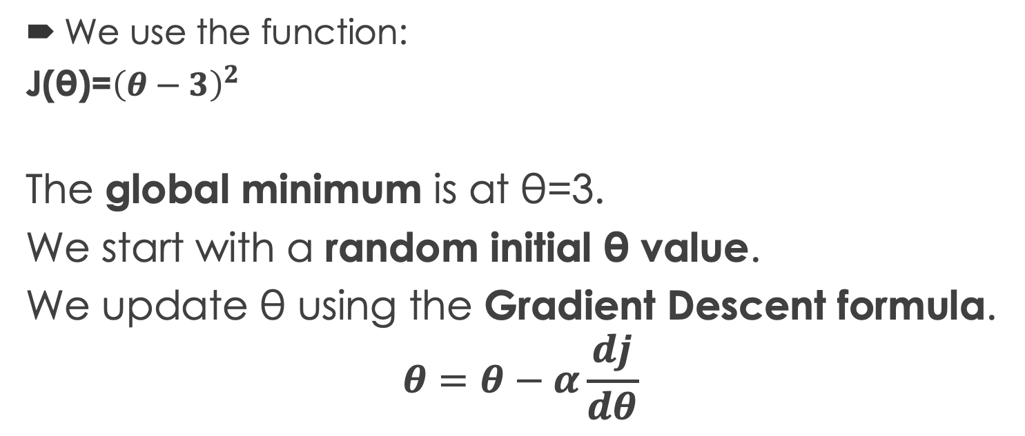
Example: Finding the Minimum of a Simple Function
We use the function:
J(θ)=${\left(θ−3\right)}^{2}$
The global minimum is at θ=3.
We start with a random initial θ value.
We update θ using the Gradient Descent formula.
$$θ=θ−α\frac{dj}{dθ}$$

Slide 10
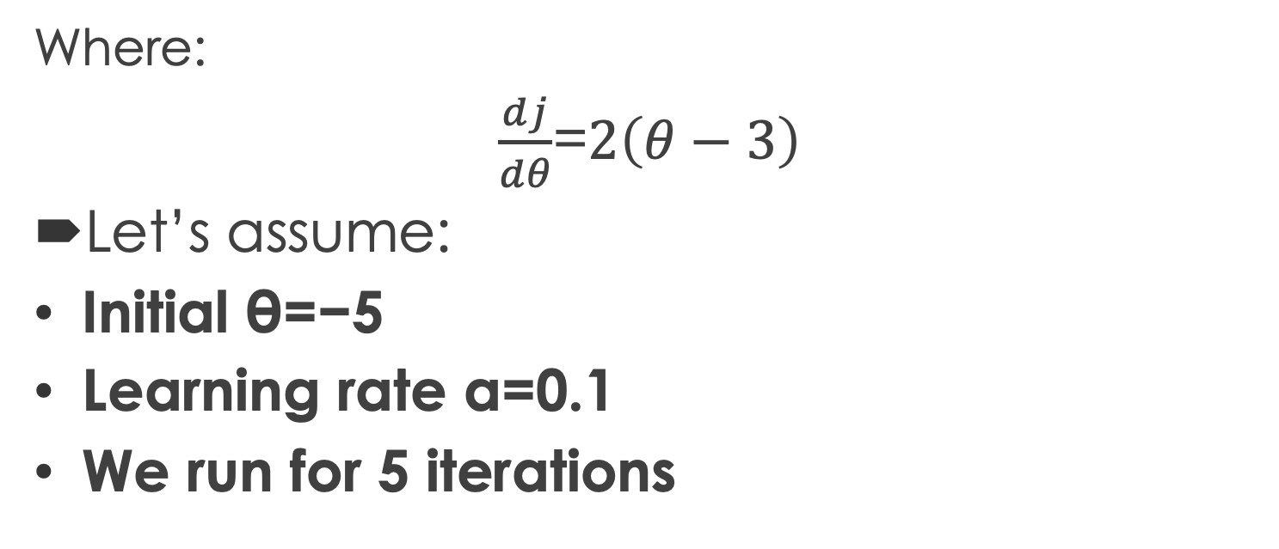
Example: Finding the Minimum of a Simple Function
Where:
$\frac{dj}{dθ}$=$2\left(θ−3\right)$
Let’s assume:
Initial θ=−5
Learning rate α=0.1
We run for 5 iterations

Slide 11
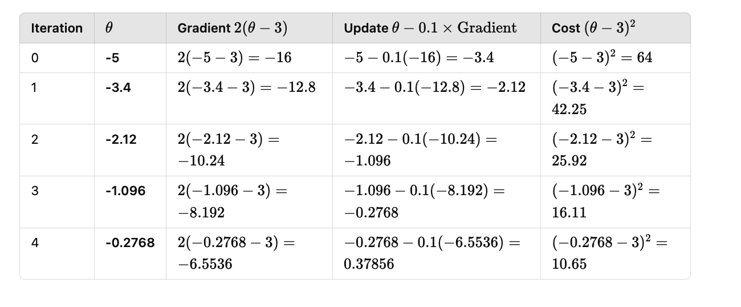
Example: Finding the Minimum of a Simple Function

Slide 12
Observations
θ moves towards 3 in each iteration.
The gradient gets smaller as θ approaches the minimum.
The cost decreases in each step.

Slide 13
Variants of Gradient Descent
Batch Gradient Descent (BGD) – Uses all training data at once (slow but stable)
Stochastic Gradient Descent (SGD) – Updates parameters for each data point (faster but noisy)
Mini-Batch Gradient Descent – A balance between BGD and SGD (uses small batches)

Slide 14
Batch Gradient Descent (BGD)
Batch Gradient Descent (Slow but Stable)
For example, you want to lose weight and reach your ideal body weight of 70 kg. You track your weight for a month, calculate your average weight loss, and then adjust your diet and exercise. This is slow but accurate because you make big adjustments based on all data at once.

Slide 15
Stochastic Gradient Descent (Fast but Noisy)
You weigh yourself every day and immediately adjust your diet based on just that day’s weight
This is faster, but sometimes random daily fluctuations (like eating extra one day) might cause overreactions

Slide 16
Advanced Optimization Algorithms
Momentum-Based GD
RMSProp (Root Mean Square Propagation)
Adam (Adaptive Moment Estimation)

Slide 17
Why Momentum-Based GD
In deep learning, we face non-convex optimization.
Consistent Gradient
Noisy Gradient

Slide 18
Momentum-Based GD
Instead of just updating using the current gradient, we accumulate past gradients to add momentum.
For example, if you want to move from point A to B, you don’t know where destination B is located, you ask four persons, and all of them tell you that B is located north. So, in between you increase your speed towards destination (B) by gaining confidence.
Faster convergence avoids oscillations.
Can overshoot if momentum is too high

Slide 19
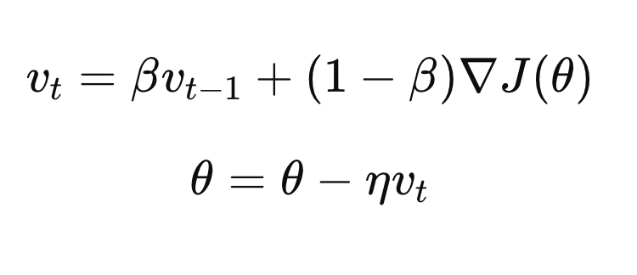
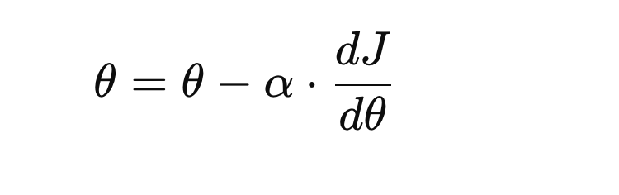
Momentum-Based GD Mathematics
Instead of just using the current gradient, Momentum GD also considers the past gradients
This helps in smoother updates and avoids zig-zagging
Momentum-Based GD
Standard GD

Slide 20
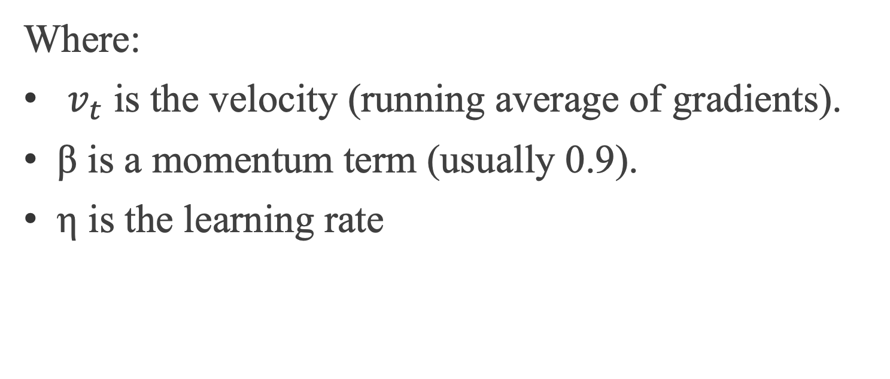
Momentum-Based GD Mathematics
Where:
$v_{t}$ is the velocity (running average of gradients).
β is a momentum term (usually 0.9).
η is the learning rate

Slide 21
Example: Ball Rolling Down a Hill
Think of a ball rolling down a hill, it gains speed gradually instead of taking small, slow steps. This helps faster convergence and reduces oscillations.

Slide 22
RMSProp (Root Mean Square Propagation)
RMSProp adapts the learning rate for each parameter based on the past gradients to avoid oscillations.
For example, you are hiking on a terrain surface. If you step too aggressively, you may fall. Instead, you take small careful steps where the ground is unstable (steep gradients) and bigger steps where the ground is flat (small gradients).

Slide 23
Adam (Adaptive Moment Estimation)
Adam combines Momentum and RMSProp

Slide 24
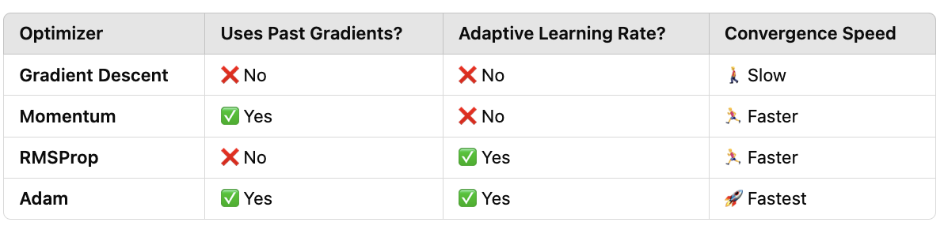
Comparisons

Slide 26
Early Stopping, and Dropout
When training neural networks, we aim to find a model that generalizes well to unseen data
However, deep networks often suffer from overfitting, where they perform well on training data but poorly on test data
To overcome this, we use regularization techniques such as Early Stopping, and Dropout.

Slide 27
Why Early Stopping?
As training progresses, the model starts memorizing the training data rather than learning general patterns
If we stop too early, the model underfits; if we train too long, it overfits

Slide 28
How does it work
Monitor the model’s performance on a validation set
If validation loss stops improving for a defined number of epochs, stop training
Saves computational resources and prevents overfitting.

Slide 30
Dropout
In deep networks, neurons develop dependencies on each other, reducing their ability to generalize.
Dropout forces the network to learn redundant and independent features

Slide 31
How does it work
Randomly deactivate (set to zero) a fraction of neurons during training
Ensures that the network doesn’t rely on specific neurons too much

